Slide 1


Slide 2
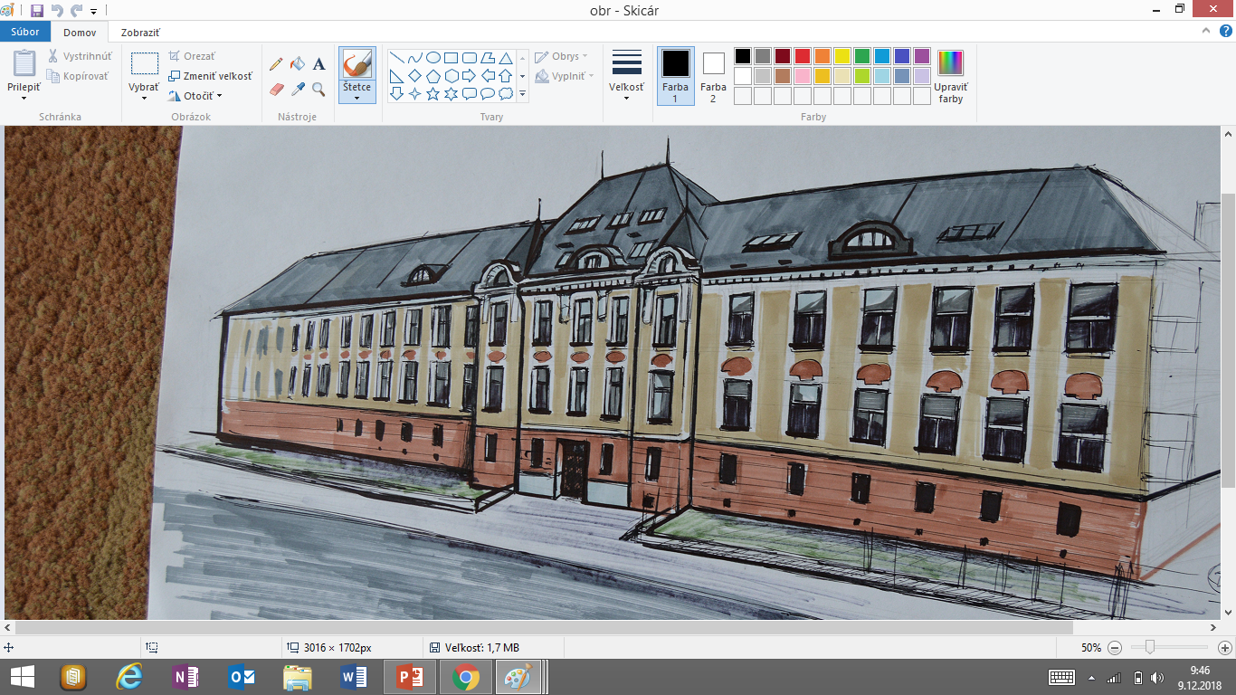
Gymnasium of Ľudovít Štúr in Trenčín has been established in 1919 and it is one of the biggest high schools not only in our region but in whole Slovakia. We are celebrating 100th year anniversary this year. There are around 800 students attending our school every year. Students may choose from 4-year or 8-year program, billingual section and they have possibility to attend our great language school as well.

Slide 3
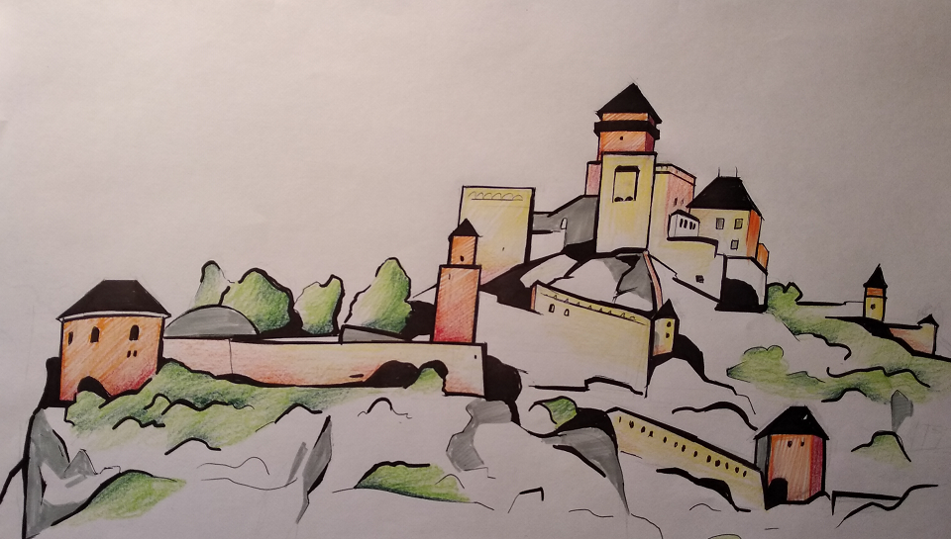
Our students have achieved excellent results in various national and international competitions.
We are students of I.D class.

Slide 4
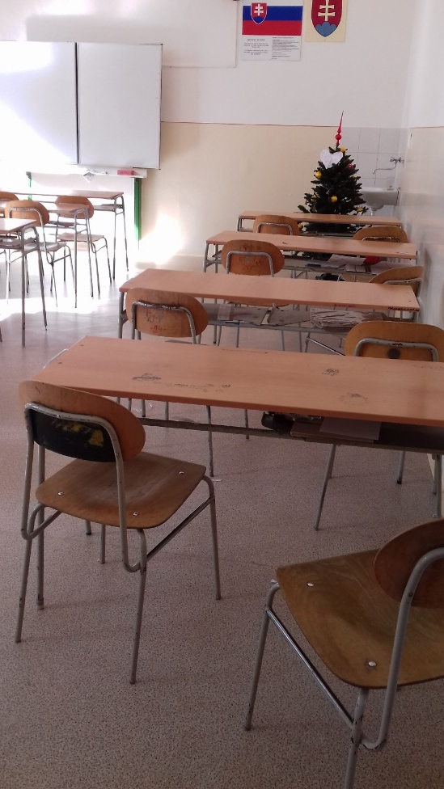
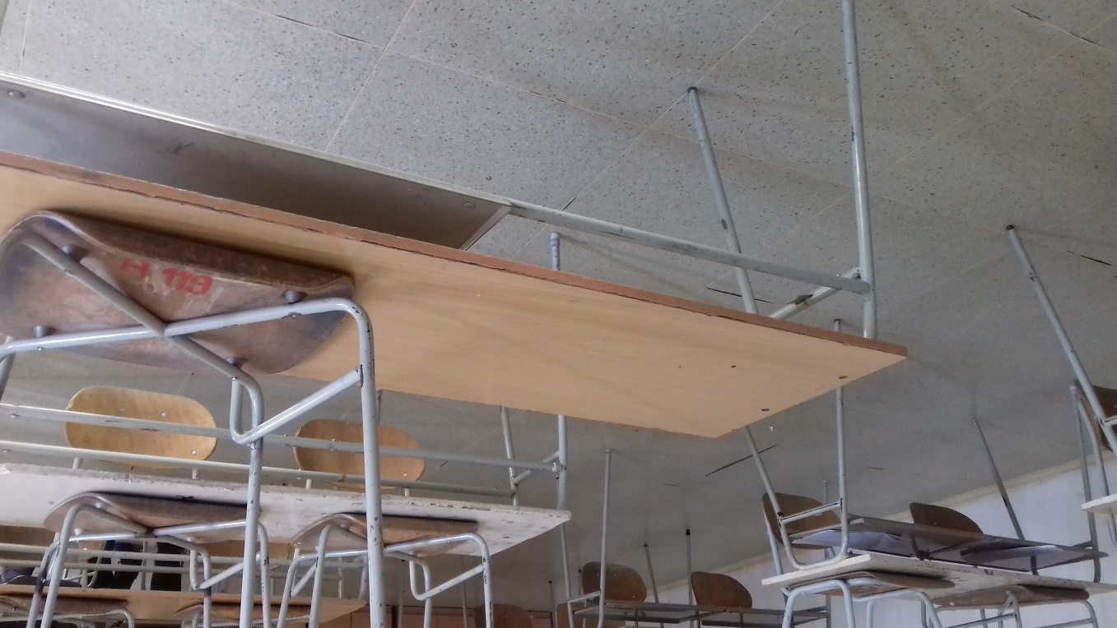
School has been permanently working on modernization of facilities which will help students to develop their abilities, talents and outlook. We successfully renovated natural science and foreign languages school rooms which are equipped with innovative equipment. However, school rooms renovation is not yet sufficient. This “old rooms” where we spend most of our time at school do not influence us in positive manner.

Slide 5
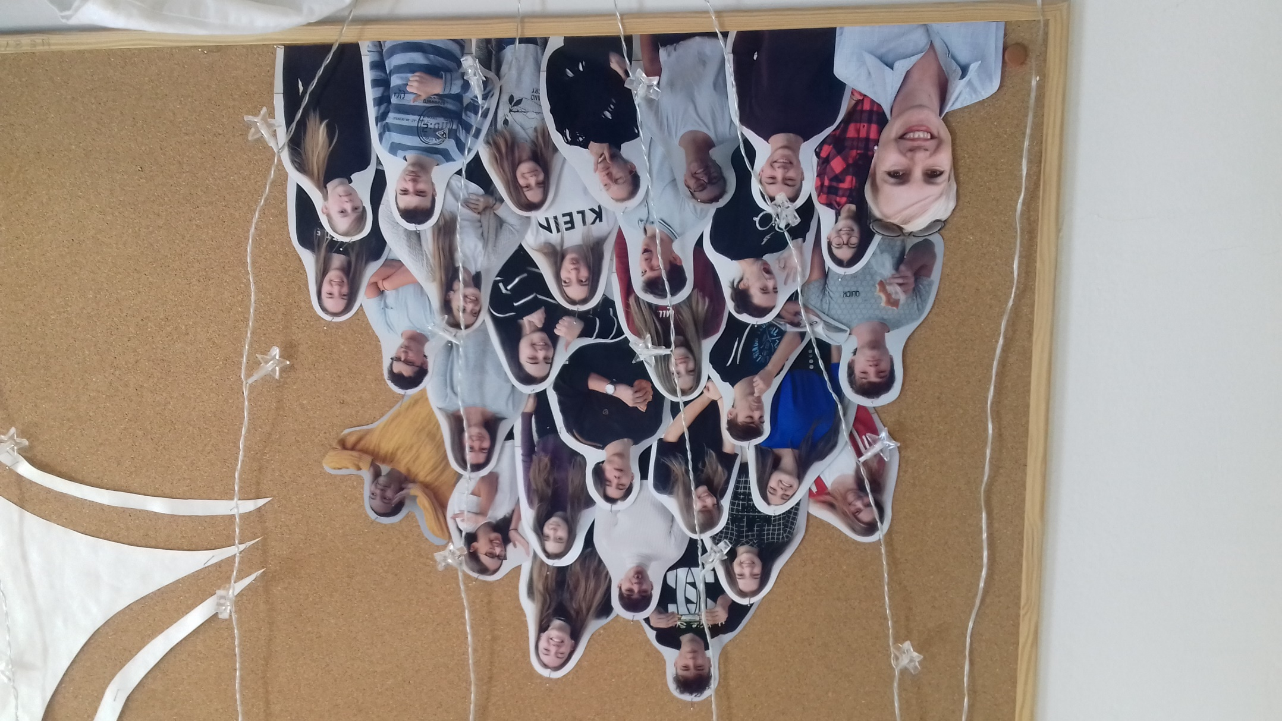
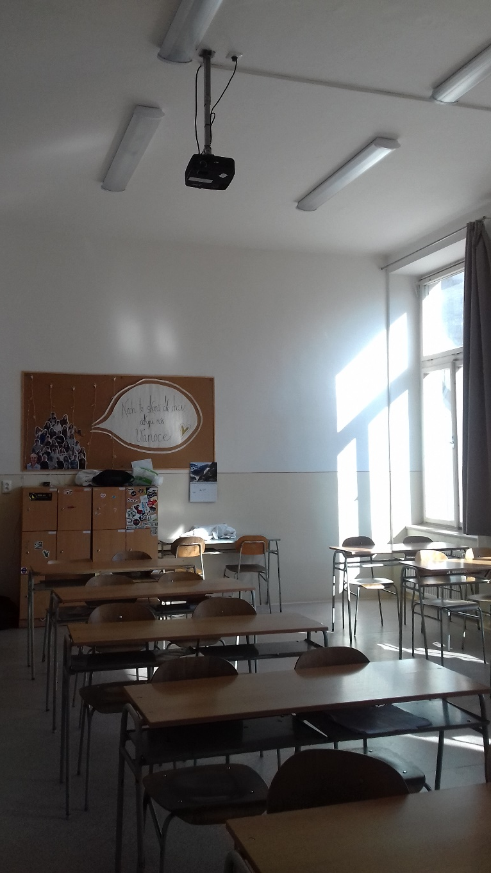
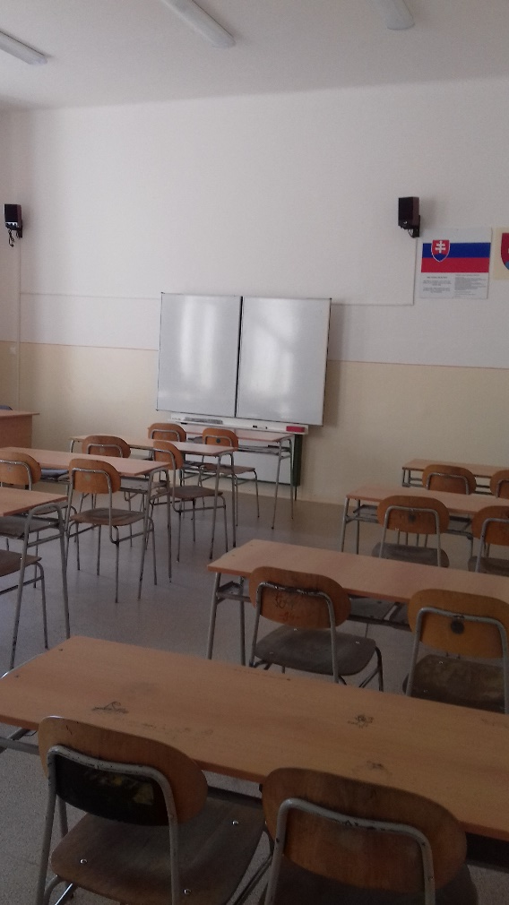
Our class

Slide 6
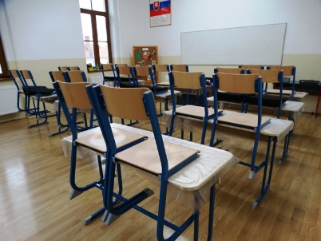
We would like to apply for a grant which could help us to renovate our school room. We plan to paint the walls, sew new curtains and eventually replace old desks and chairs.

Slide 7
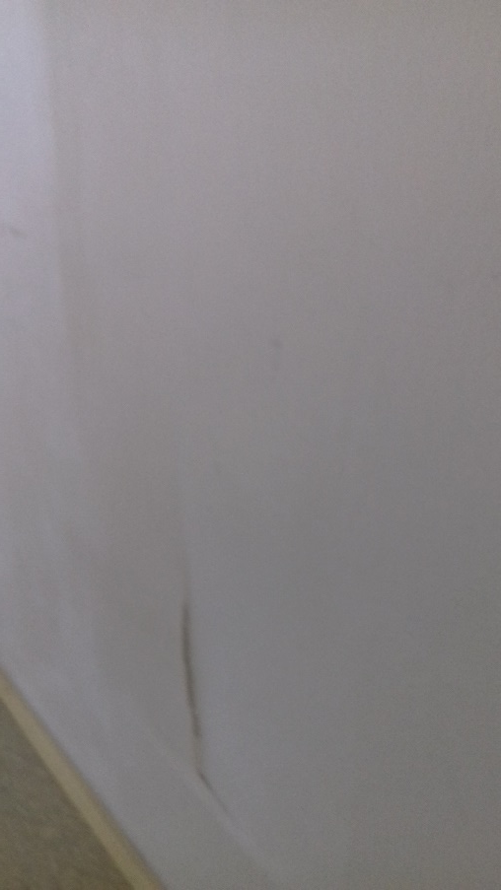
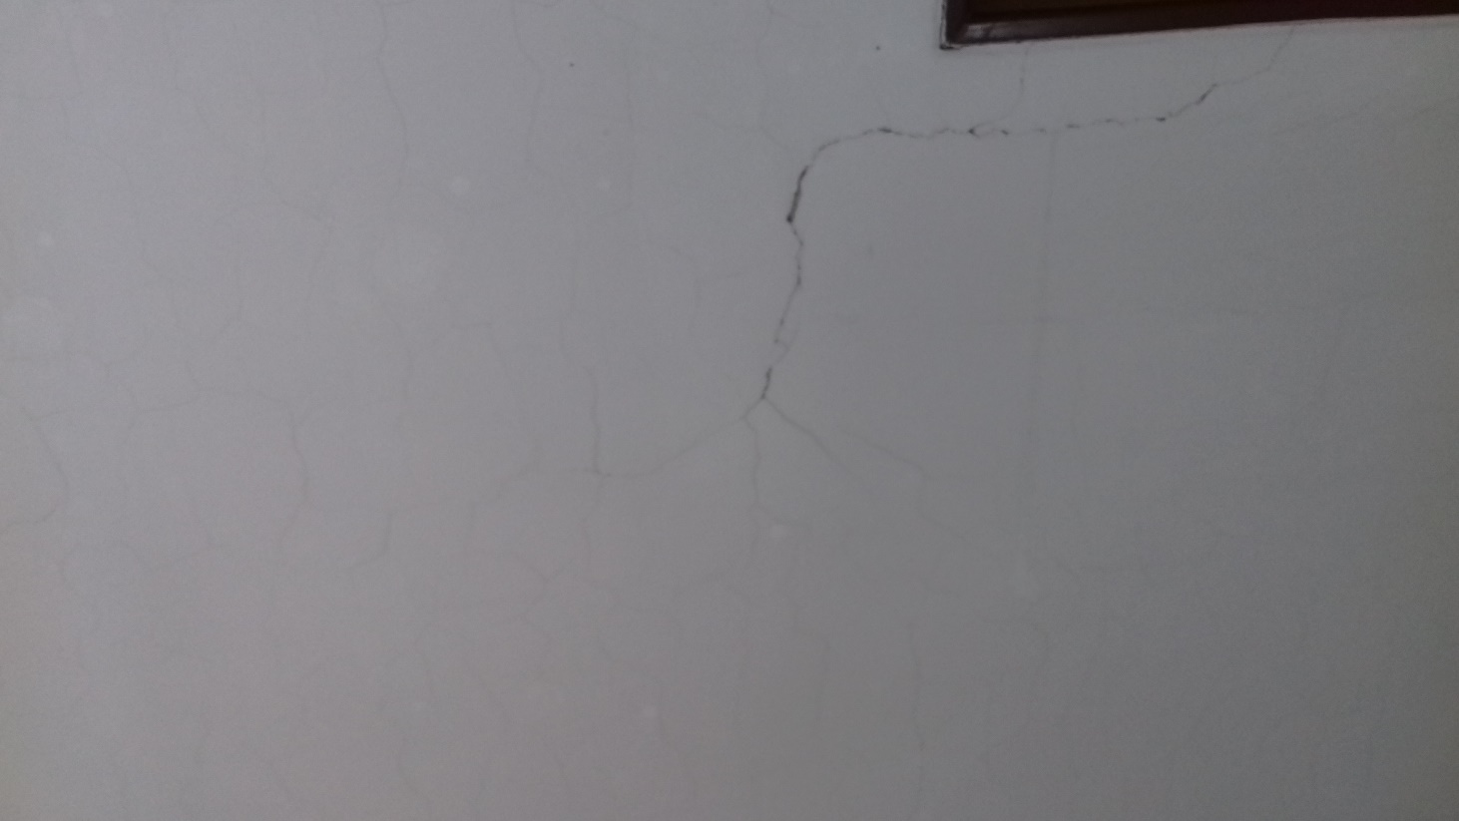
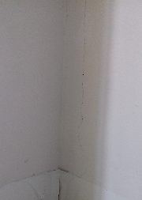
Reconstruction of old painting

Slide 8
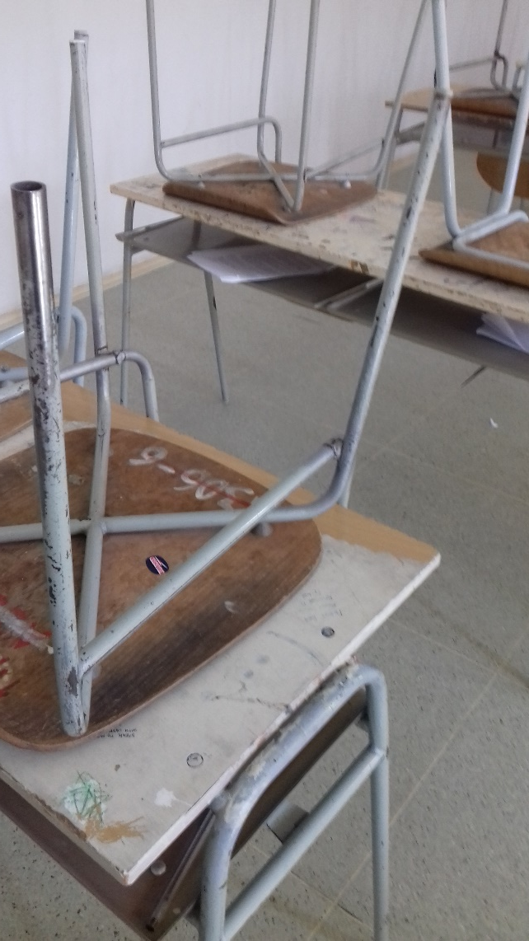
What we need to make it happen
- we would need $ 1000 grant
- 5 Yanfeng employees, students and teacher
- project will be done in cooperation
with school management
- around 30-40 working hours
painting and cleaning of old walls, sewing of new
curtains, painting and renovation of desks
- purchase of material: painting color,
sewing fabric, new desks & chairs

Slide 9
