Slide 1
Global Positioning System

Slide 2
Introduction
Orientation in space
Creation of maps
Development of astronautics – artificial satellites
Improvement of system

Slide 3
Thesis's objectives
Theoretical explanation how system works, what it consist of and what roles have its parts. Designation of parameters, which must be counted in measurement for accurate calculating.
Practical measurement of latitude and longitude, focusing on accuracy of the system – how big error the system causes.

Slide 4
Structure – space part
24 satellites, 6 orbits
Inclination from equatorial plane 55°
Separated by 60° right ascension of the accenting node
Average orbital level 20 200 km above Earth
Period 11 h 58 min
Orbital speed 3,8 km/s
Role:
  Communication with headquarters and user part
  Detection of start of ballistic rockets (since block IIR)

Slide 5
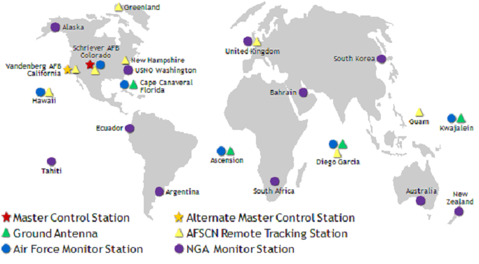
Structure – control part
Land stations:
  MCS – Master Control Station, Rocky mountains military base Falcon in Colorado USA, communication with other stations
  Command and monitor stations – communication with satellites

Slide 6
Structure – user part
users‘ receivers (mobile, tablet ...)
Role – latitude, longitude, altitude and speed calculation
users‘ groups:
  Authorised – USA army, service PPS, P(Y) code, special receivers
  Other – civilian sector, service SPS, C/A code, classic receivers
Receivers according to number of channels:
  Single-channel – 1 channel, signal receiving only from 1 satellite at once, channel switching when wants to receive from another satellite
  Multi-channel – more channels, signal receiving from more satellites at once, more accurate calculating

Slide 7
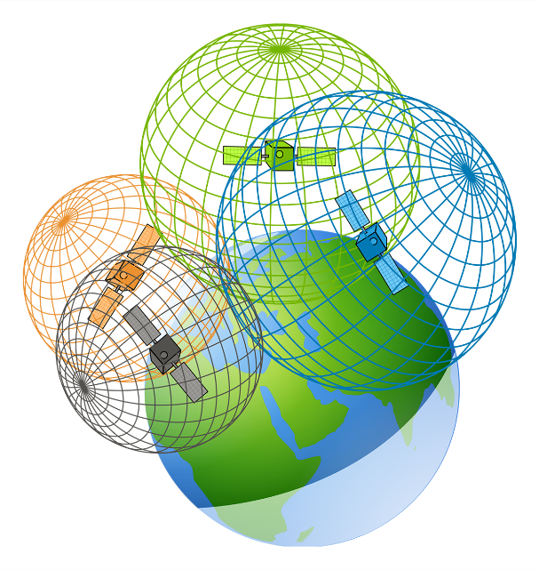
Position determining
Ellipsoid a reference system WGS 84
Cartesian co-ordinate system
Method of distance measurement (finding of point of intersection of spherical surfaces)

Slide 8
Position determining
Relativistic effects of satellites' clock – general and special relativistic theory, clocks setting at earthly time
Signal refraction – charged particles in ionosphere cause signal refraction, in troposphere has affluence weather
Barrier – reflected signal or lack of it, can causes also noise
DOP – Dilution of Precision, satellites distribution
Movements – Earth rotation, GPS receivers and satellites movements

Slide 9
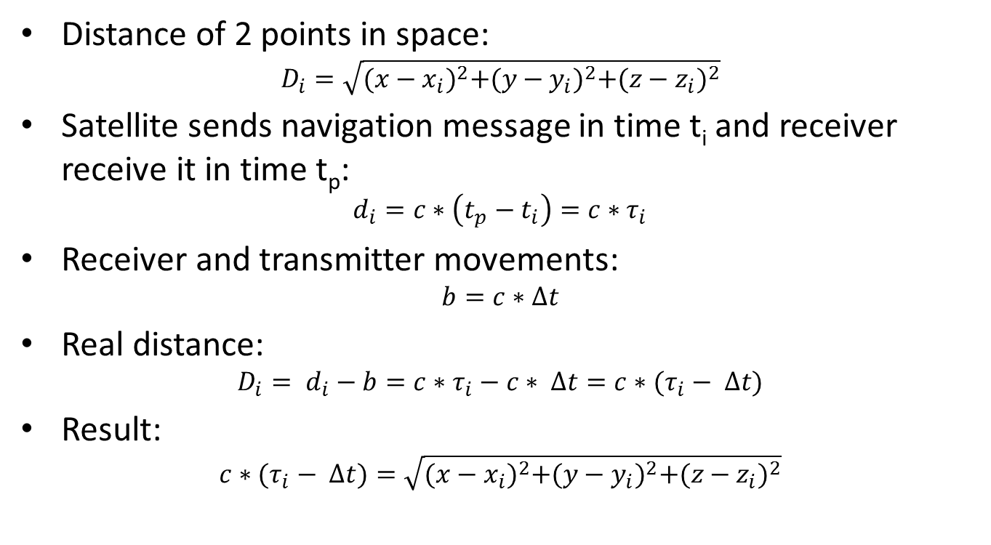
Position determining
Distance of 2 points in space:
$$D_{i}=\sqrt{{(x−x_{i})}^{2}+{(y−y_{i})}^{2}+{(z−z_{i})}^{2}}$$
Satellite sends navigation message in time t_{i} and receiver receive it in time t_{p}:
$$d_{i}=c∗\left(t_{p}−t_{i}\right)=c∗τ_{i}$$
Receiver and transmitter movements:
$$b=c∗Δt$$
Real distance:
$$D_{i}= d_{i}−b=c∗τ_{i}−c∗ Δt=c∗(τ_{i}− Δt)$$
Result:
$$c∗(τ_{i}− Δt)=\sqrt{{(x−x_{i})}^{2}+{(y−y_{i})}^{2}+{(z−z_{i})}^{2}}$$

Slide 10
Measurement of accuracy of system
Tools: GPS navigation from GARMIN
Advance:
  Navigation setting
  Choose a point, set navigation into it, wait until co-ordinates reach final value.
  After recording value we move device into another point. Then we give the device back into our chosen point. Pay attention to arrange it in the same way.
  10 measurements for 1 point
2 measurement series: interior and exterior

Slide 11
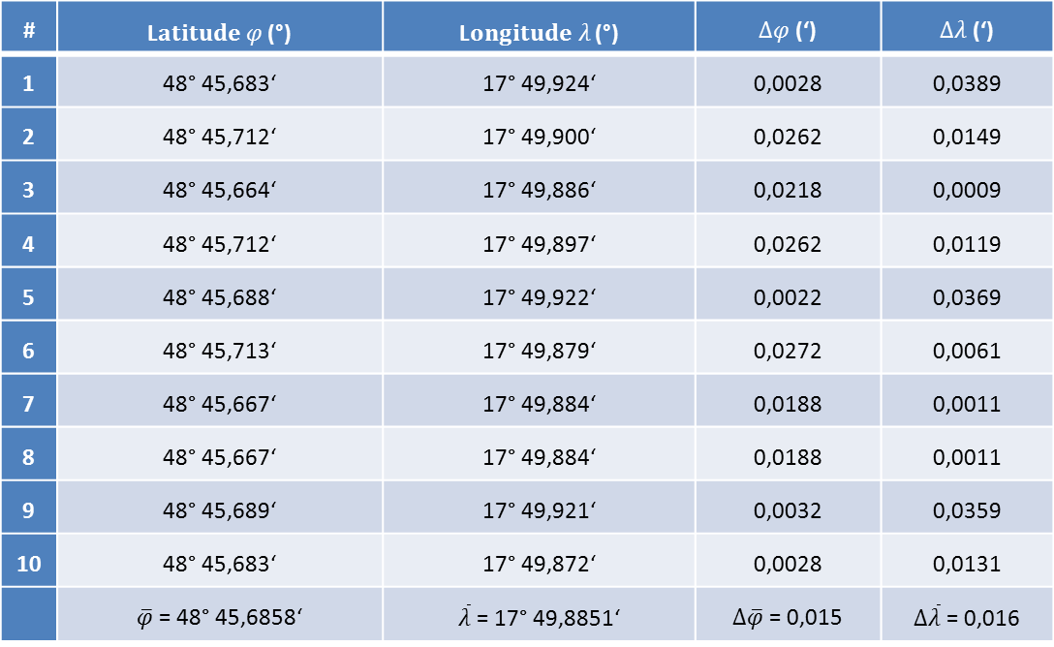
Measurement of accuracy of system – interior
# | L$atitude φ$ (°) | L$ongitude λ$ (°) | $Δφ$ (‘) | $Δλ$ (‘)
1 | 48° 45,683‘ | 17° 49,924‘ | 0,0028 | 0,0389
2 | 48° 45,712‘ | 17° 49,900‘ | 0,0262 | 0,0149
3 | 48° 45,664‘ | 17° 49,886‘ | 0,0218 | 0,0009
4 | 48° 45,712‘ | 17° 49,897‘ | 0,0262 | 0,0119
5 | 48° 45,688‘ | 17° 49,922‘ | 0,0022 | 0,0369
6 | 48° 45,713‘ | 17° 49,879‘ | 0,0272 | 0,0061
7 | 48° 45,667‘ | 17° 49,884‘ | 0,0188 | 0,0011
8 | 48° 45,667‘ | 17° 49,884‘ | 0,0188 | 0,0011
9 | 48° 45,689‘ | 17° 49,921‘ | 0,0032 | 0,0359
10 | 48° 45,683‘ | 17° 49,872‘ | 0,0028 | 0,0131
 | $\overline{φ}$ = 48° 45,6858‘ | $\overline{λ}$ = 17° 49,8851‘ | $Δ\overline{φ}$ = 0,015 | $Δ\overline{λ}$ = 0,016

Slide 12
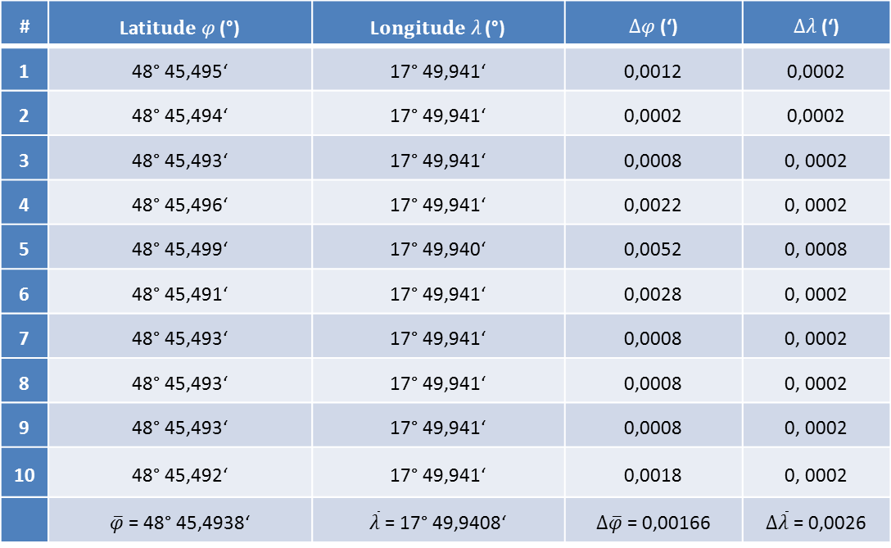
Measurement of accuracy of system – exterior
# | Lat$itude φ$ (°) | L$ongitude λ$ (°) | $Δφ$ (‘) | $Δλ$ (‘)
1 | 48° 45,495‘ | 17° 49,941‘ | 0,0012 | 0,0002
2 | 48° 45,494‘ | 17° 49,941‘ | 0,0002 | 0,0002
3 | 48° 45,493‘ | 17° 49,941‘ | 0,0008 | 0, 0002
4 | 48° 45,496‘ | 17° 49,941‘ | 0,0022 | 0, 0002
5 | 48° 45,499‘ | 17° 49,940‘ | 0,0052 | 0, 0008
6 | 48° 45,491‘ | 17° 49,941‘ | 0,0028 | 0, 0002
7 | 48° 45,493‘ | 17° 49,941‘ | 0,0008 | 0, 0002
8 | 48° 45,493‘ | 17° 49,941‘ | 0,0008 | 0, 0002
9 | 48° 45,493‘ | 17° 49,941‘ | 0,0008 | 0, 0002
10 | 48° 45,492‘ | 17° 49,941‘ | 0,0018 | 0, 0002
 | $\overline{φ}$ = 48° 45,4938‘ | $\overline{λ}$ = 17° 49,9408‘ | $Δ\overline{φ}$ = 0,00166 | $Δ\overline{λ}$ = 0,0026

Slide 13
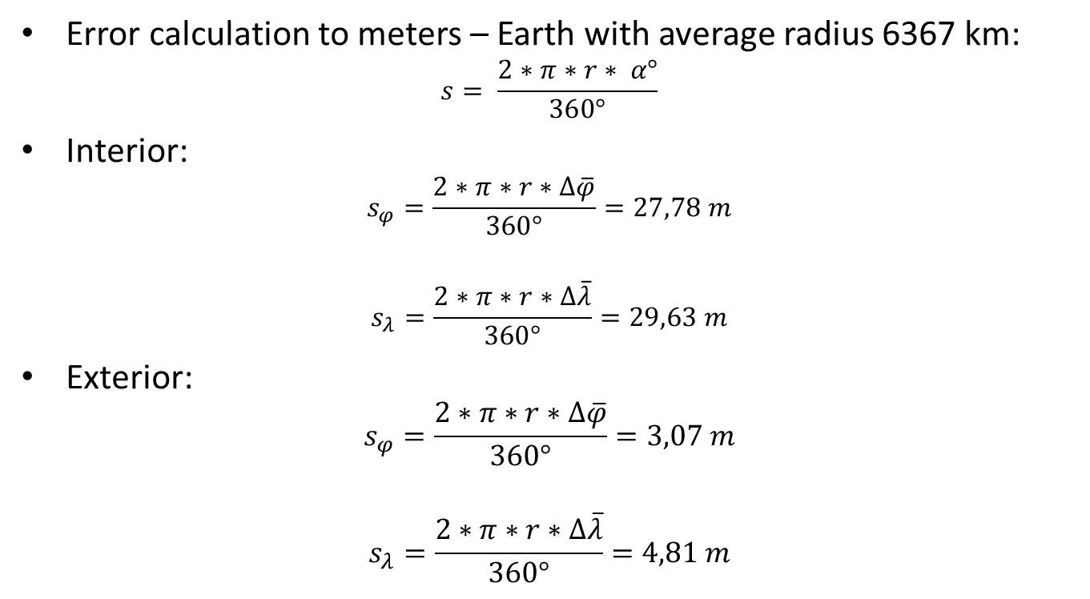
Results and discussion
Error calculation to meters – Earth with average radius 6367 km:
$$s= \frac{2∗π∗r∗ α°}{360°}$$
Interior:
$$s_{φ}=\frac{2∗π∗r∗Δ\overline{φ}}{360°}=27,78 m$$
$$s_{λ}=\frac{2∗π∗r∗Δ\overline{λ}}{360°}=29,63 m$$
Exterior:
$$s_{φ}=\frac{2∗π∗r∗Δ\overline{φ}}{360°}=3,07 m$$
$$s_{λ}=\frac{2∗π∗r∗Δ\overline{λ}}{360°}=4,81 m$$

Slide 14
Results and discussion – errors reasons
Common factors :
  Signal refraction
  Satellites ephemerides
  System time
Different factors:
  Barriers
  DOP

Slide 15
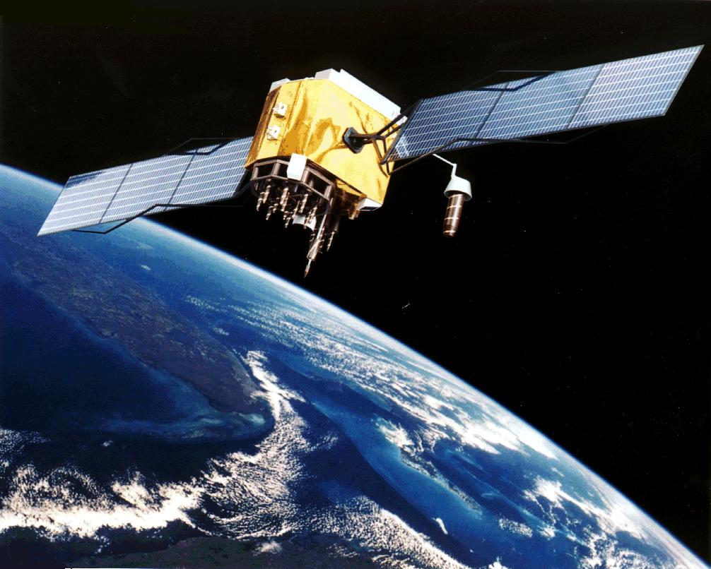
Conclusion
High sensitivity of system to many factors
Improvement: DGPS, more satellites for better calculation
Another systems: GLONASS, Galileo, BeiDou

